Slide 1
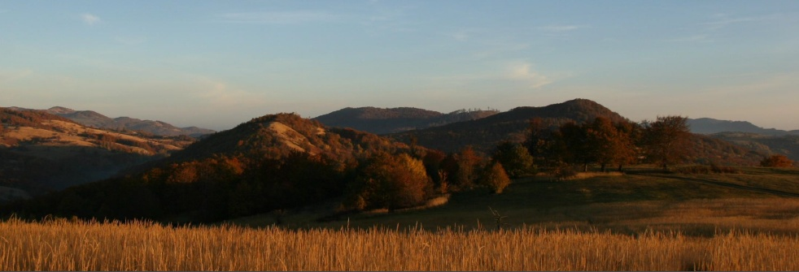
Mineral resources of Serbia
Rade Jelenkovic
University of Belgrade - Faculty of Mining & Geology
43 EuroGeoSurveys General Meeting (EGS) - 43 Directors Workshop – Mineral Resources Potential
Geological Survey of Serbia

Slide 2
Topics
43 EuroGeoSurveys General Meeting (EGS) - 43 Directors Workshop – Mineral Resources Potential
General informations
Metallogeny
Mineral deposits – present state and future
Geological exploration - Limitations
Geological Survey of Serbia

Slide 3
Studies (2007-2011)
The presented data are based on
Mineral resources and potencial prognosis of metallic mineral raw materials in Serbia
Mineral resources and potencial prognosis of non-metallic mineral raw materials in Serbia
Mineral resources and potencial prognosis of fosil fuels in Serbia
Prepared by
Jelenković R., Mijatović P., Jovanović J., Kostić A. et all
Geological Institute of Srbia (Geological Survey of Serbia)
Faculty of Mining and Geology – Belgrade University

Slide 4
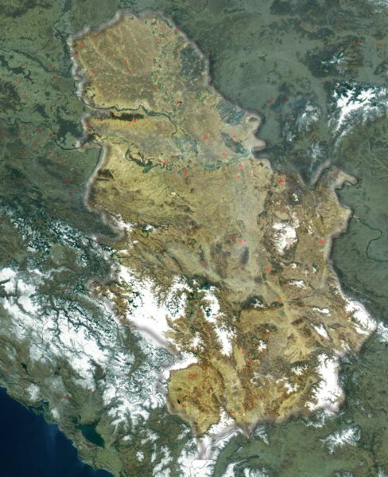
43 EuroGeoSurveys General Meeting (EGS) - 43 Directors Workshop – Mineral Resources Potential
1) General informations
Republic of Serbia
88,361 km²
Population:
7,186,862
(excluding Kosovo)
0.059% of the World’s
land surface
0.133% of the World’s population
Geological Survey of Serbia

Slide 5
43 EuroGeoSurveys General Meeting (EGS) - 43 Directors Workshop – Mineral Resources Potential
1) General informations
Annual production
(average)
Mining and briquetting of coal
Lignite 45,000,000 t
Brown coal 350,000 t
Bituminous coal 142,000 t
Extraction of crude petroleum and natural gas
Crude petroleum 1,020,000 t
Natural gas 617,000,000 m³
Mining of metal ores
Copper ore 12,200,000 t
Lead–zinc ore 412,000 t
Geological Survey of Serbia

Slide 6
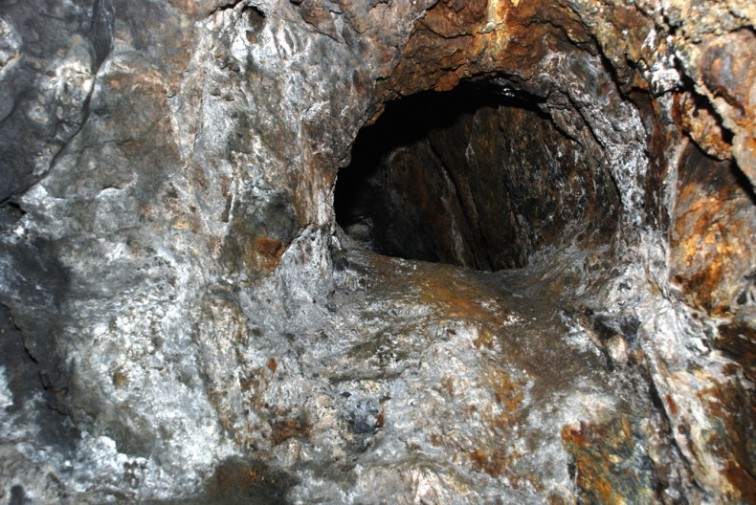
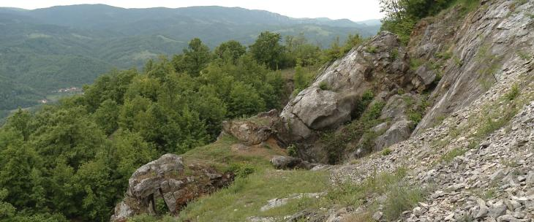
History
43 EuroGeoSurveys General Meeting (EGS) - 43 Directors Workshop – Mineral Resources Potential
Mining activity in Serbia has started
about 7,000 years ago and it is
the oldest one in Europe.
In Rudna Glava (near Majdanpek)
copper and iron were exploited.
Rudna Glava
Cu-Fe skarn
Geological Survey of Serbia

Slide 7
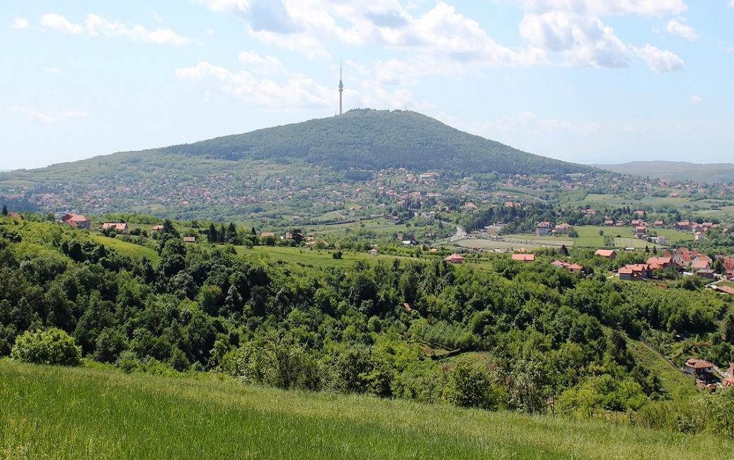
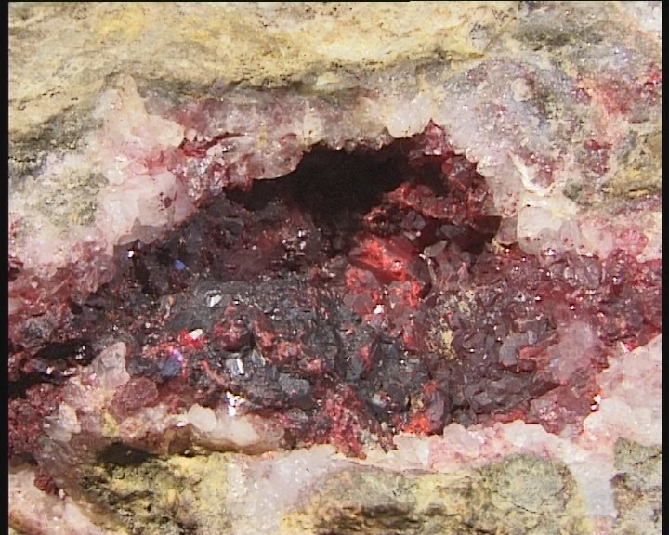
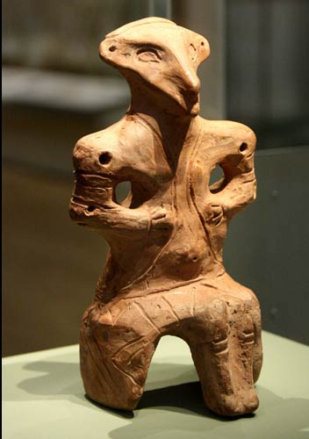
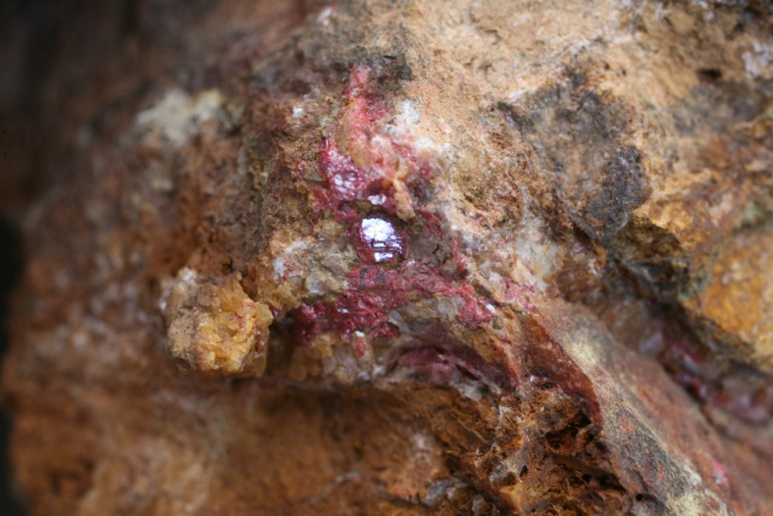
History
43 EuroGeoSurveys General Meeting (EGS) - 43 Directors Workshop – Mineral Resources Potential
On Avala Mountain (Belgrade) mercury is exploited during Neolithic time, in the period of Vinča culture. (4-5.000 B.C.)
Geological Survey of Serbia

Slide 8
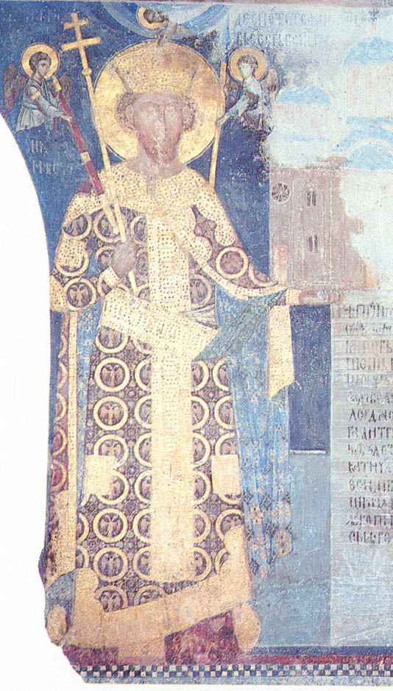
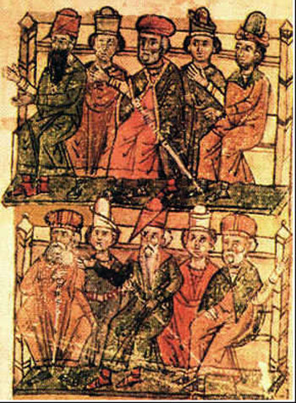
43 EuroGeoSurveys General Meeting (EGS) - 43 Directors Workshop – Mineral Resources Potential
First Mining Law in Serbia is more then 600 years old – XV century.
  1412 – Stefan Lazarevic (Stevan the Tall)
The most important period is 1946-2017 - significant discoveries:
  > 3,500 metallic and nonmetallic deposits and occurrences,
  46 coal basins (13 in exploitation),
  90 oil and gas fields, >250 deposits,
  40 productive oil and gas fields; also CO₂ deposits and
  > 20 deposits and occurrences of oil shale.
Despot Stefan Lazarevic
Mining Law – Cover page
Geological Survey of Serbia

Slide 9
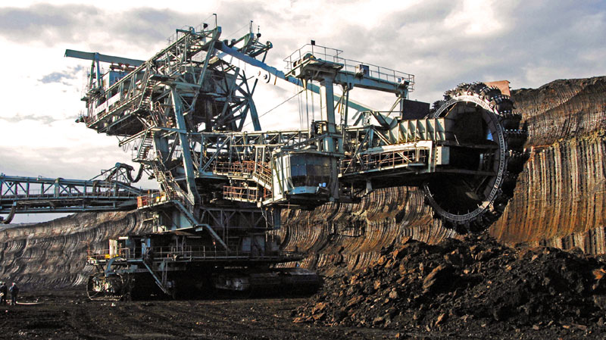
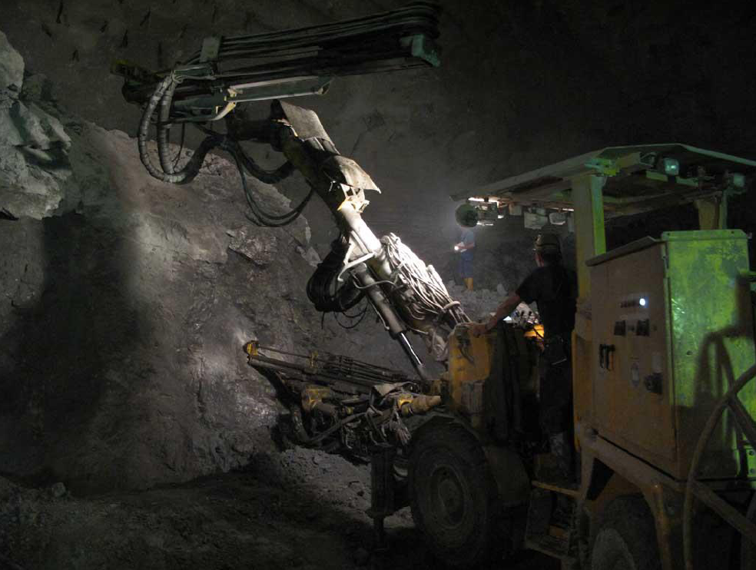
Present state
43 EuroGeoSurveys General Meeting (EGS) - 43 Directors Workshop – Mineral Resources Potential
Contribution of mining industry to GDP of Serbia is 1.5%
Plan: 3-5% in next 10 years !
Mining industry:
  25,000 workers; 1.8% of totaly employed in Serbia
  >50% of workers are employed in coal production.
Annual investments in exploration: ~60 mill. US$
  >20 exploration companies, >200 exploration rights
  >270 mining companies (technical and architectual stone prevails)
Geological Survey of Serbia

Slide 10
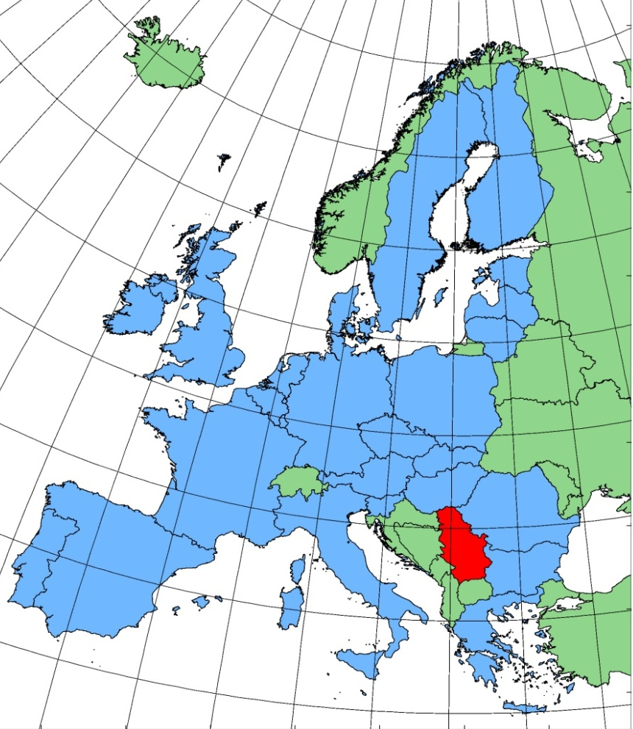
43 EuroGeoSurveys General Meeting (EGS) - 43 Directors Workshop – Mineral Resources Potential
Government committed to stimulating foreign investments.
No restrictions on foreign ownership.
10% corporate tax rate & 5% NSR.
Up to 10 year tax holidays for projects with an investment > €7M and employing > 100 staff.
Tax credit incentives on capital purchases (up to 10 years).
Conclusion:
Serbia is a good place for investments
in exploration and mining !!!
Geological Survey of Serbia

Slide 11
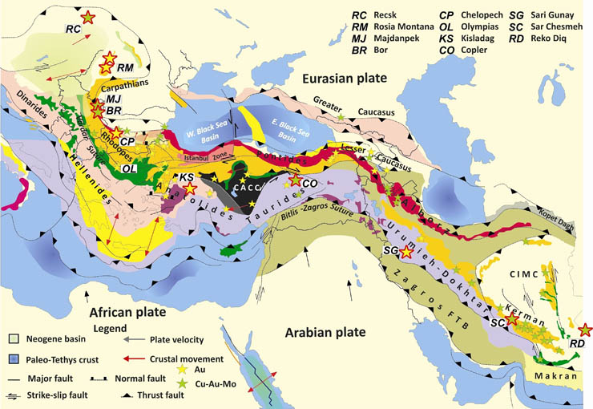
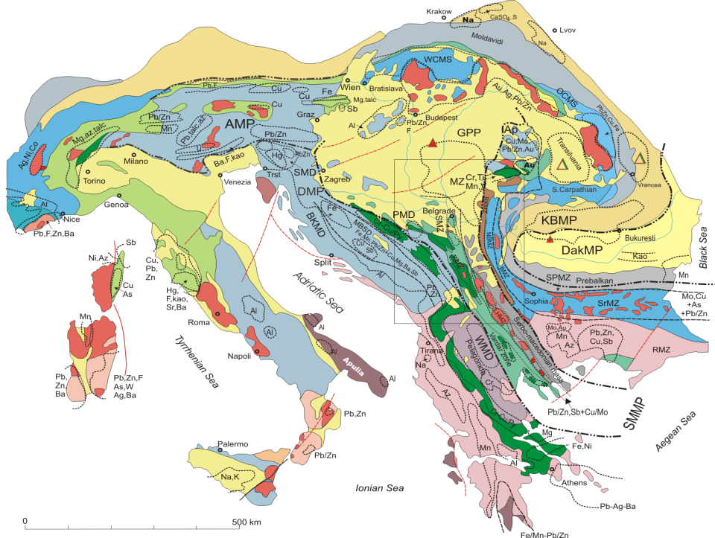
Metallogenic position
Tethyan-Eurasian Metallogenic Belt
Janković S., 1977
ABCD
The Alpine–Balkan–Carpathian–Dinaride metallogenic and geodynamic province
Heinrich, Ch., Neubauer F., 2012
Janković S., 1977
The North-Eastern Mediterranean Sector of the Tethyan-Eurasian Metallogenic Belt
Metallogenic units of the Serbia are a part of
regional metallogenic units which extend beyond
the territorial limits of the country.
Geological Survey of Serbia

Slide 12
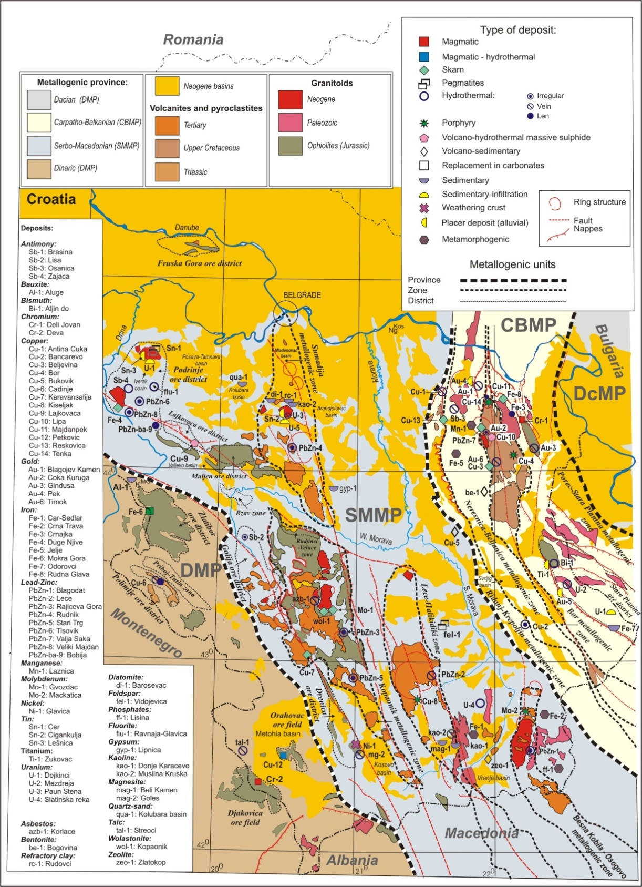
Metallogenic zoning:
Dinaric metallogenic province (DMP) covering western part of the Serbia.
Serbo-Macedonian metallogenic province (SMMP) in the central part of the Serbia, covering the terrains of the Vardar zone, the Serbo-Macedonian Mass and eastern part of Dinarides.
Carpatho-Balkanian metallogenic province (CBMP) in the north-eastern part of the Serbia.
Dacian metallogenic (DcMP) province that include an extremely small area in the far north-eastern part of Serbia.
DcMP
SMMP
CBMP
DMP
Geological Survey of Serbia

Slide 13
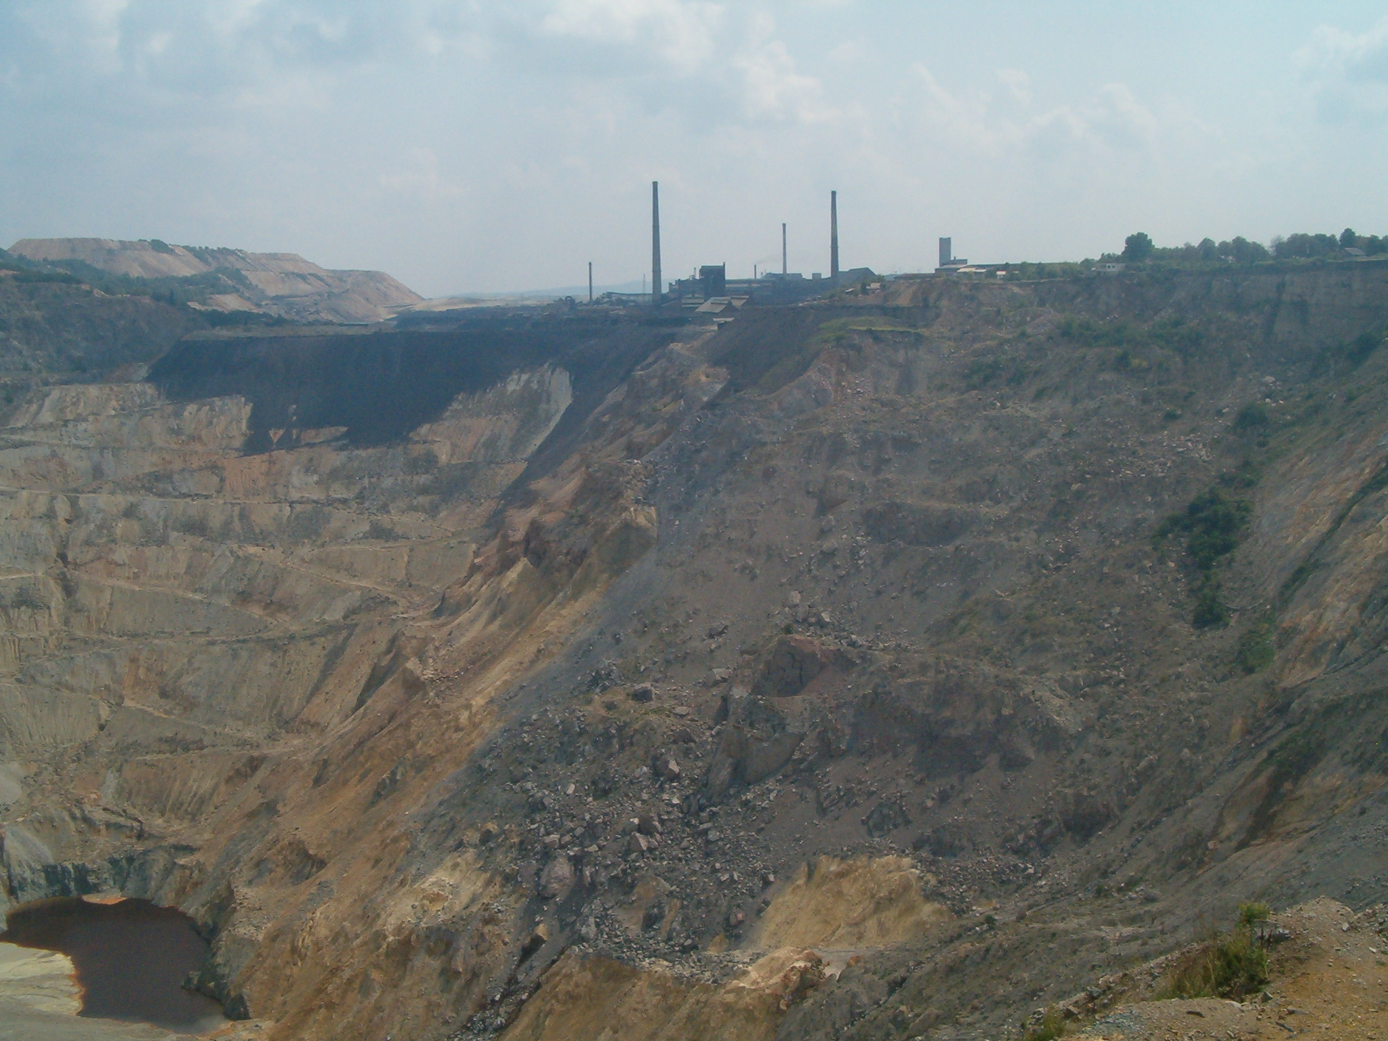

Mineral resources of Serbia :
Present state and future
43 EuroGeoSurveys General Meeting (EGS) - 43 Directors Workshop – Mineral Resources Potential
Metallic mineral deposits
Industrial minerals and rocks
Fosil fuels
Geological Survey of Serbia

Slide 14
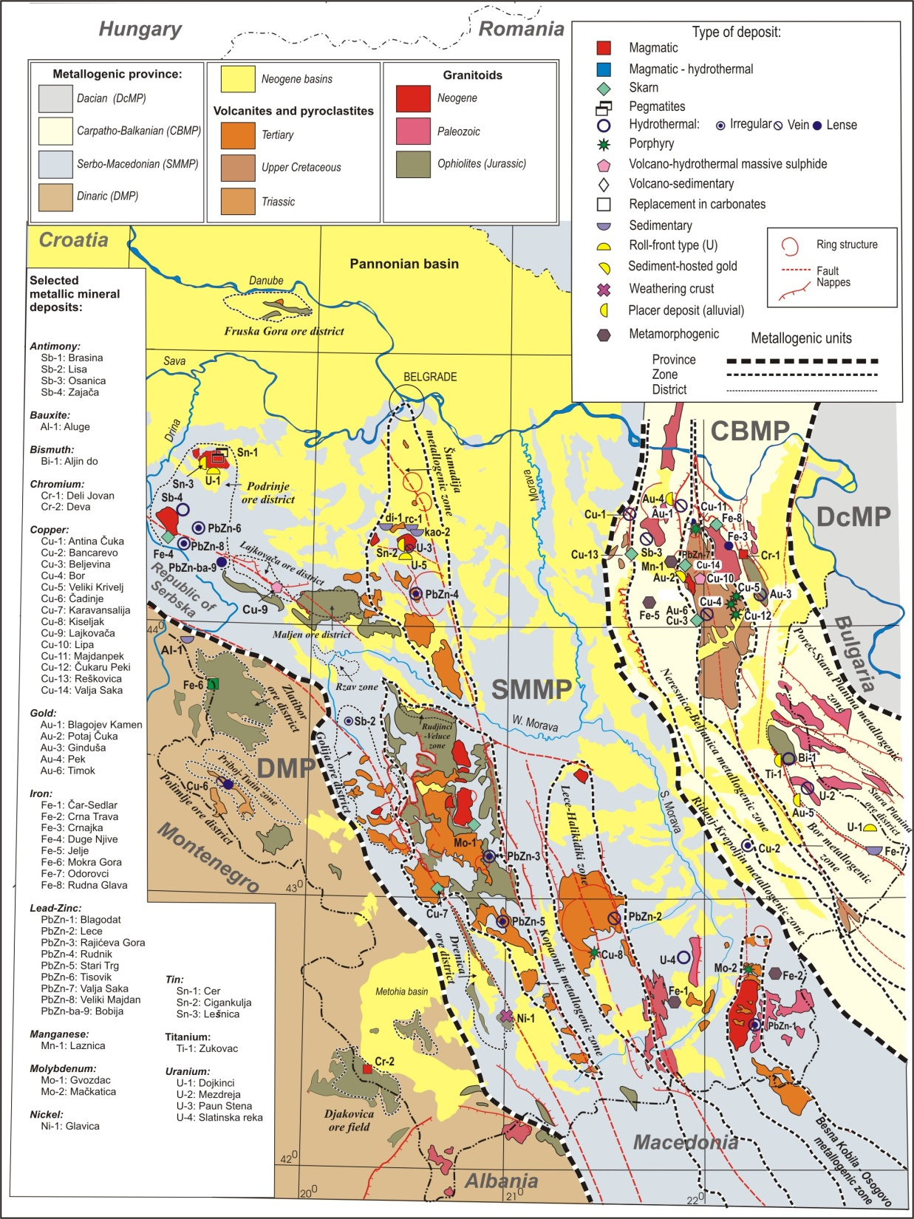
METALLIC MINERAL RESOURCES
OF SERBIA
There are more then 2000 metallic mineral deposits and mineral occurrences at territory of Serbia
Jelenkovic & Mijatovic, 2007-2011: Mineral resources and potencial prognosis of metallic mineral raw materials in Serbia.
Geological Survey of Serbia

Slide 15
Metallic mineral resources of Serbia - classification
43 EuroGeoSurveys General Meeting (EGS) - 43 Directors Workshop – Mineral Resources Potential
Group | Commodity | Remarks
1. Active exploitation, significant resources & reserves | Cu (Au), Pb-Zn (Ag) | Mostly low metal content, great potential.
2. No exploitation but resources identified | Mo, U, Sn, W Mn, Ti | Small resources, mostly limited importance. Resource increase foreseen (U).
3. Potentially important, partially defined resources | Ni, Co, Sb, Al, Fe (naturally mixed) | Economic valorization depend on technical and economic parameters. Resources increase but economically limited.
4. Resources expected | Au, Ag, RE | Resources increase foreseen, additional exploration required.
5. Mostly exhausted or non-commercial | Cr, Fe | Low chance of new discoveries; possibly in deeper levels of productive peridotite massifs.
Geological Survey of Serbia

Slide 16
Metallic mineral resources of Serbia
Ministry of Mining end Enegry
 | Measured + Indicated Resources |  |  | Inferred Resources
 | Tonnage | Grade | Metal | Tonnage | Grade | Metal
Cu¹ Au¹ Ag¹ | 1250 Bt | 0.38 % 0.138 g/t 1.04 g/t | 4.75 Mt 173 t 1295 t | 1350 Bt | 0.37 % 0.11 g/t 0.95 g/t | 4.99 Mt 149 t 1285 t
Cu² Au² |  |  |  | 300.5 Mt | 0.27 % 0.26 g/t | 811.4 t 78.13
Cu³ Au³ |  |  |  | 63 Mt | 2.6% 1.5 g/t | 1.638 Mt 94.5 t
Au⁴ | 46.3 Mt | 1.56 g/t | 72.3 t | 8.7 Mt | 1.3 g/t | 11.31 t
Pb Zn Ag | 16.27 Mt | 4% 3% 95 g/t | 0.65 Mt 0.49 Mt 1545 t | 2.69 Mt | 4% 3% 82.8 g/t | 0.11 Mt 0.08 Mt 223 t
Pb⁵ Zn⁵ Ag⁵ | 31.26 Mt | 4.1 % 3 % 110 g/t | 1.28 Mt 0.94 Mt 3438 t | 24.47 Mt | 4% 3% 70 g/t | 0.98 Mt 0.73 Mt 1713 t
Ni | 19.92 Mt | 0.75 % | 149400 t | 18.73 Mt | 1.14 % | 213522 t
Co | 19.92 Mt | 0.08% | 15936 t | 18.73 Mt | 0.07% | 13111 t
Sb | 0.98 Mt | 1.53 % | 14994 t | 1.2 Mt | 1.3 % | 15600 t
Mo | 150 Mt | 0.044 % | 66000 t | 164.5 Mt | 0.07 % | 115150 t
Fe Ni⁶ | 3.97 Mt - | 37.53 % - | 1.49 Mt - | 115.4 Mt 90 Mt⁶ | 23.99% 0.7% | 27.68 Mt 0.63 Mt
Mn | - | - | - | 9.5 Mt | 20 % | 1.9 Mt
Cr | 89000 | 15.7% | 13973 t | 0.02 Mt | 15 % | 3000 t
Ti | - | - | - | 56000t | 42% TiO₂
Al | 2.69 Mt | 44-48% Al₂О₃ | - | 1,2 Mt | 35-40% Аl₂О₃ | -
SnO₂ | 5.49 Mm³ | 286.3 g/m³ | 1572 t | 20Mm³ | 167 g/m³ | 3340 t
Ta-Nb | 4.96 Mm³ | 86.01 g/m³ | 427 t | 20 Mm³ | 10 g/m³ | 200 t
W | 0.33 Mt | 3.5% WO₃ | 11500 t WO₃ | 0.025 Mt | 1.65% WO₃ | 412.5 t WO₃
Hg | 0.083 Mt | 0.33 % | 27390 t | - | - | -
U | 2.154 Mt | 338 g/t | 728.1 t | 1.5 Mt | 310 g/t | 465 t
Primary economic significance
Cu, Au, Pb-Zn-Ag
Secondary
economic
significance
Tertyary
economic
significance
Explanation: ¹: RTB Bor. ²: Kiseljak deposit. ³Čukaru Peki. ⁴: Potaj Čuka-Tisnica. ⁵: Kosovo. ⁶: Mokra Gora basin.

Slide 17
Metallic mineral deposits of
primary economic significance
Copper and gold
Bor metallogenic zone
Lece-Halkidiki metallogenic zone
Lajkovača ore district
...
Beside copper, from these deposits gold, silver, platinum, palladium and other metals also exploited.
The potential ore-bearing areas have been defined (Bor metallogenic zone and Lece-Halkidiki metallogenic zone).
Geological Survey of Serbia

Slide 18
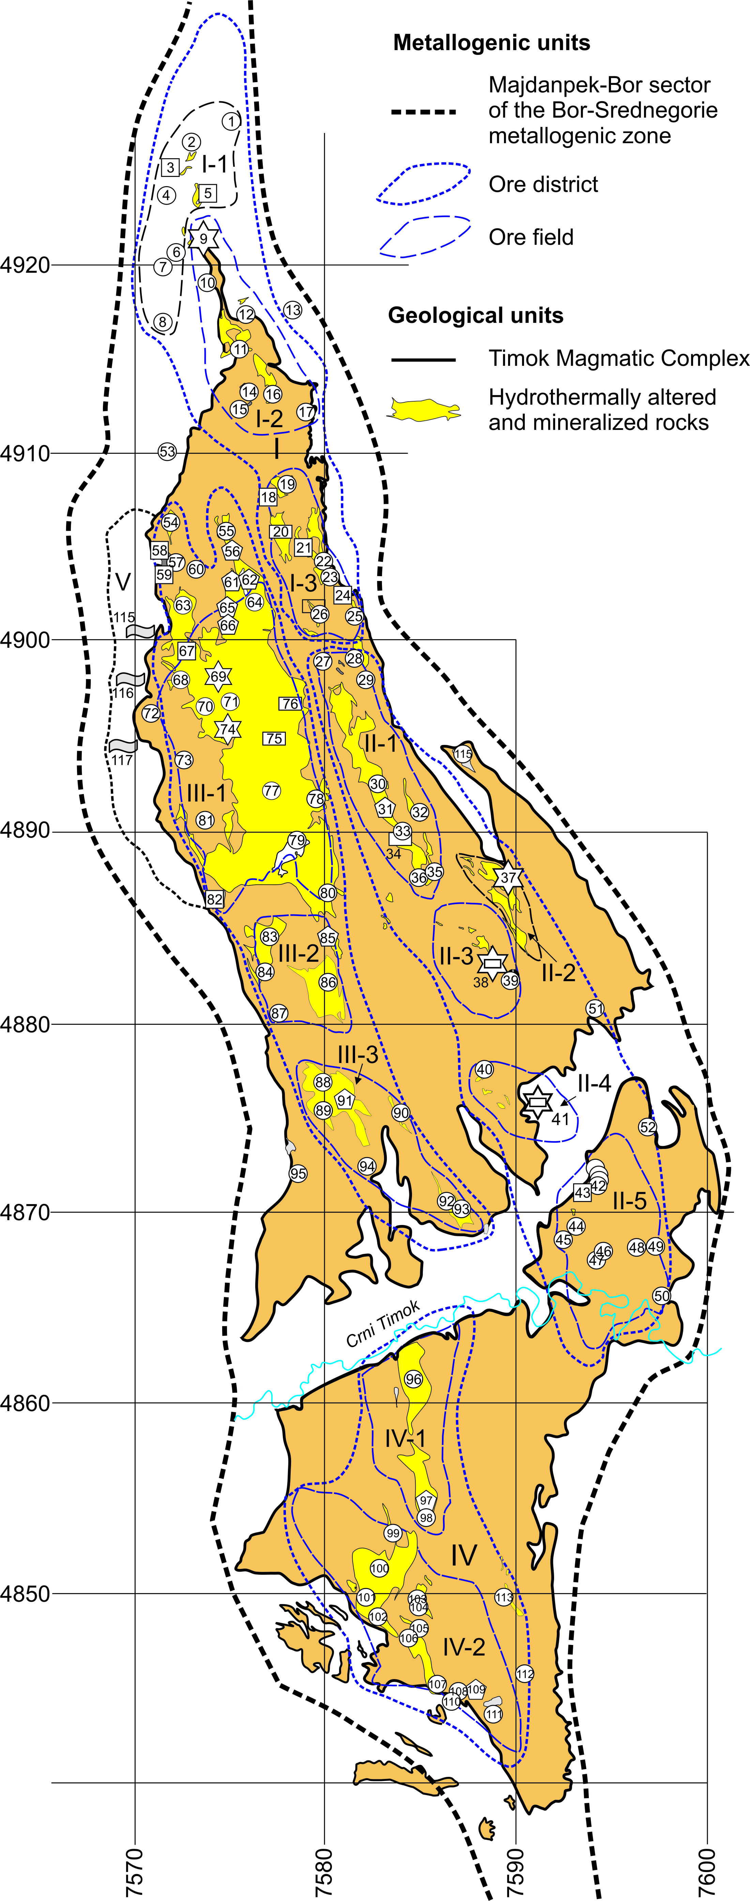
Metallic mineral resources of the BMZ
Different morphogenetic types of deposits. Display diversity in ore paragenesis, associations of minerals and elements and belongs to different morphogenetical types of ore mineralization.
Major ore elements of the Bor metallogenic zone are:
  Cu, Au, Mo, Fe (Py) ± Pb-Zn.
Trace elements are:
  Se, PGE, Ag, Cd (recoverable) and
  W, Sn, Bi, Sb, As, (Ba) (unrecoverable)
Associations of elements are classified according types of mineralization as follows:
Porphyry copper: Cu, Au, Mo ± Ag, PGE
Massive sulphide Cu-Pb-Zn: Cu, Pb/Zn, Fe (Py), Au/Ag ± Se, Bi, Sb
Cupriferous massive sulphide: Cu, Au, Fe(Py), As±W, Sn, Se, Sb
Massive pyrite: Fe-S
Skarn deposit: Cu, Fe (Py) ± Mo, Bi, W
Geological Survey of Serbia

Slide 19
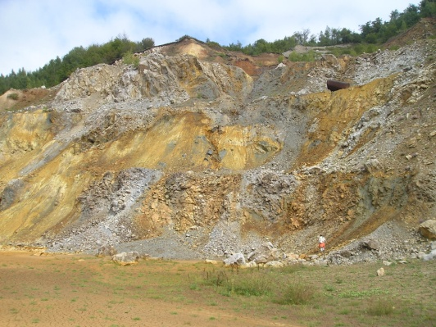
Metallic mineral resources of the BMZ
Over 120 ore deposits and mineral occurrences are situated in the BMZ.
All of them are gruped into
5 ore districts with 15 ore fields.
Majdanpek ore district
  Tilva-Toma ore field
  Majdanpek ore field
  Vlaole-Jasikovo ore field
Bor ore district
  Bor ore field
  Veliki Krivelj ore field
  Cerova - Mali Krivelj ore field
  Brestovac ore field
  Crveni Breg ore field
Crni Vrh ore district
  Crni Vrh ore field
  Crvena reka ore field
  Tilva Njagra ore field
Markov Kamen-Gradiste ore district
  Savinac ore field
  Markov Kamen ore field
  Gradiste ore field
Borovo-Donje Nevlje ore district
  Donje Nevlje ore field
Current estimated Measured and Indicated mineral resources (reserves of A, B and C₁ category by Serbian classification) are:
1.25 Bt @ 0.38% Cu, 0.14 g/t Au (4.75 Mt Cu, 173 t Au).
Total mineral resources: 2.4 Bt
Annual production: 8-12 Mt
Geological Survey of Serbia

Slide 20
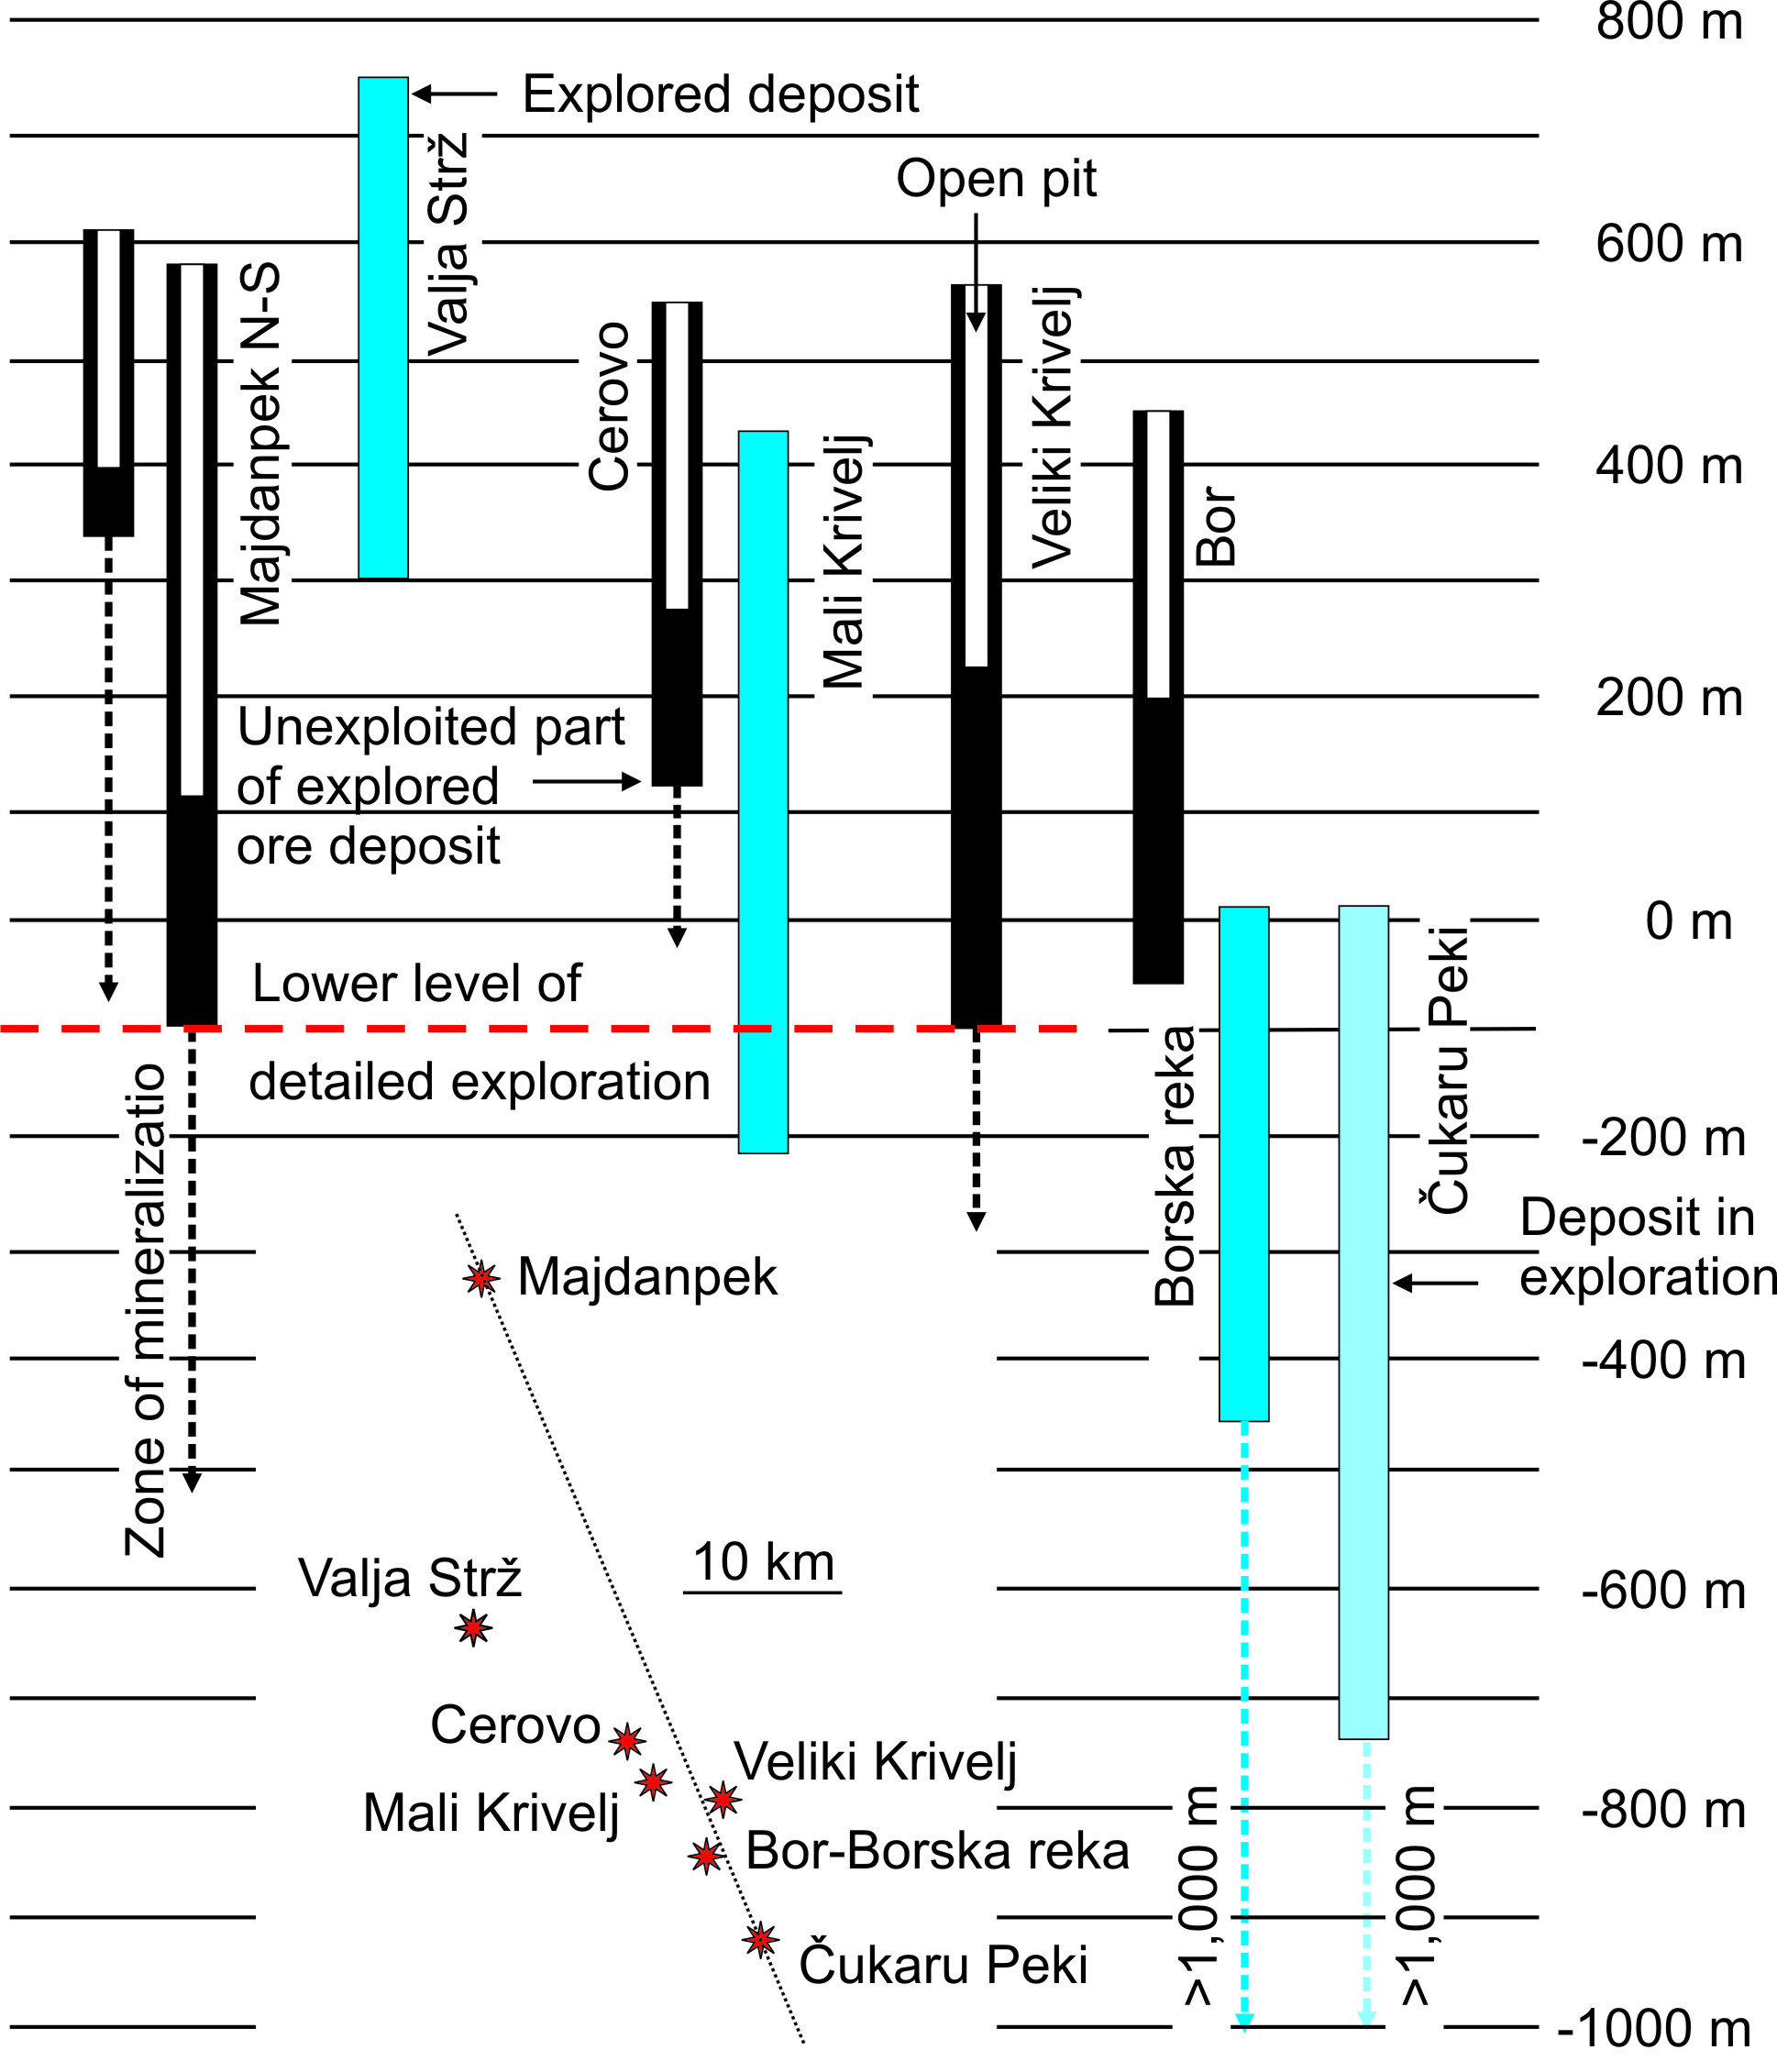
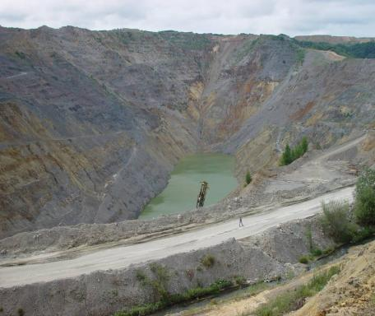
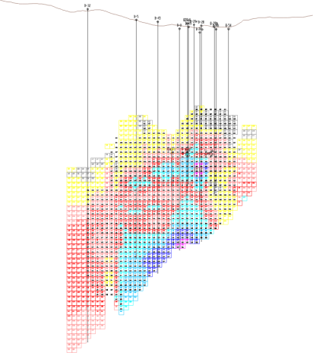
43 EuroGeoSurveys General Meeting (EGS) - 43 Directors Workshop – Mineral Resources Potential
Majdanpek deposit
Geological Survey of Serbia

Slide 21
2) Lead, zinc (silver)
mineral deposits
Numerous and economically significant.
Serbo-Macedonian metallogenic province:
Šumadija metallogenic zone
Kopaonik metallogenic zone
Lece-Halkidiki metallogenic zone
Podrinje ore district
Besna Kobila metallogenic zone
Dinaric metallogenic province:
Polimlje ore district,...
Measured + Indicated resources | 16.27 Mt | 4% Pb 3% Zn 95 g/t Ag
Inferred resources | 2.69 Mt | 4% Pb 3% Zn 82,75 g/t Ag

Slide 22
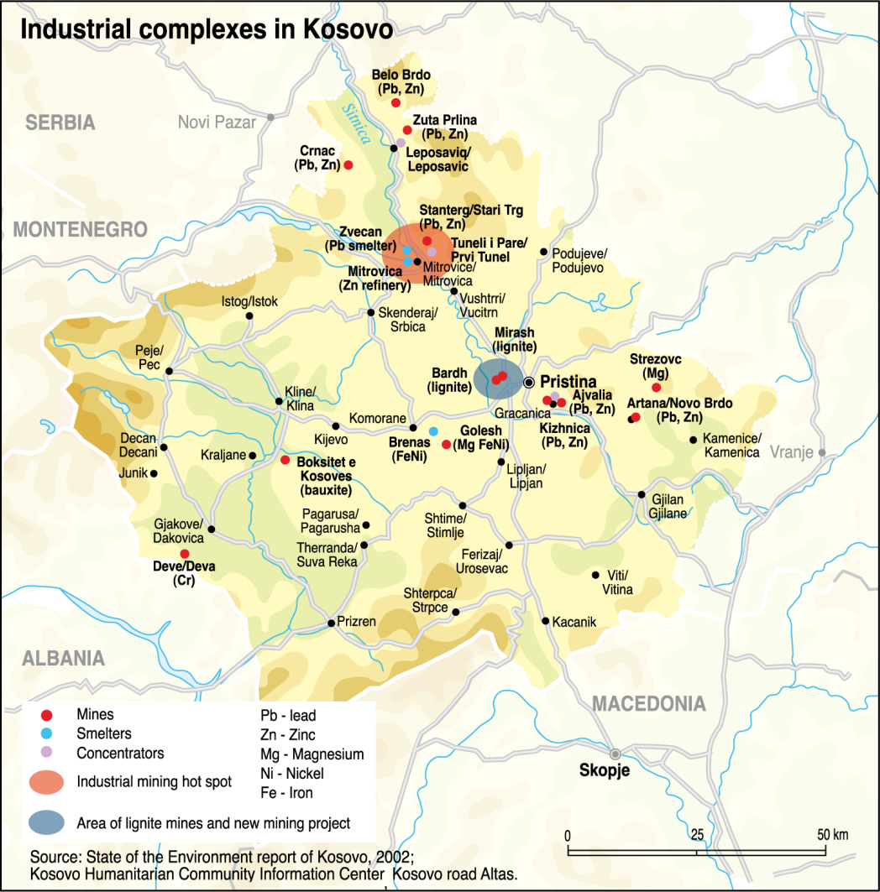
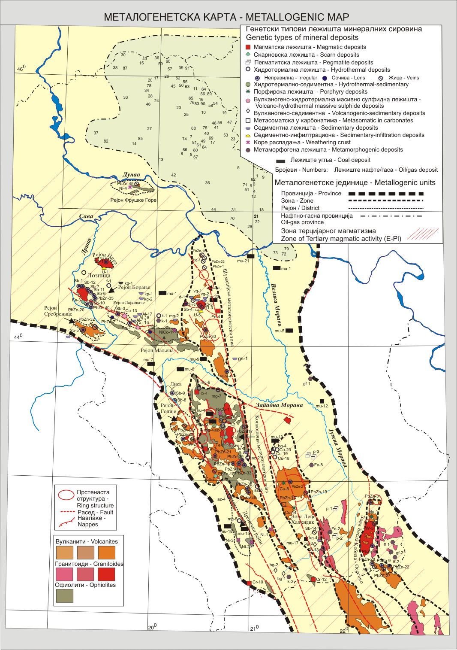
43 EuroGeoSurveys General Meeting (EGS) - 43 Directors Workshop – Mineral Resources Potential
Measured + Indicated resources | 31.26 Mt | 4.1% Pb 3% Zn 110 g/t Ag
Inferred resources | 24.47 Mt | 4% Pb 3% Zn 70 g/t Ag
Geological Survey of Serbia

Slide 23
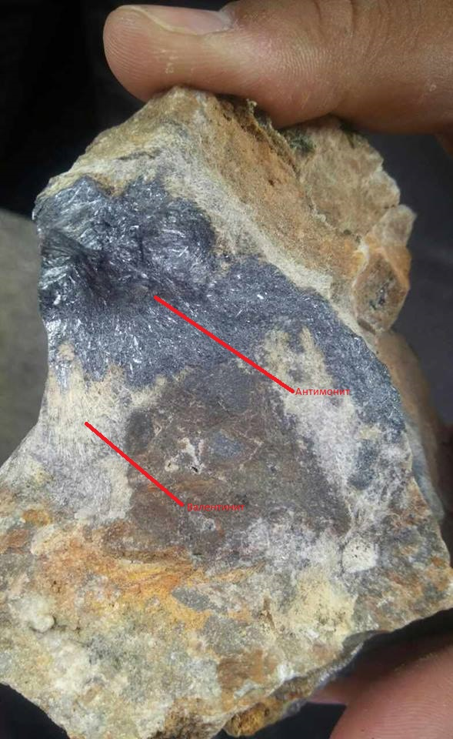
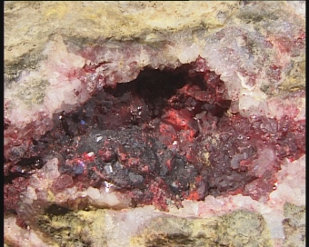
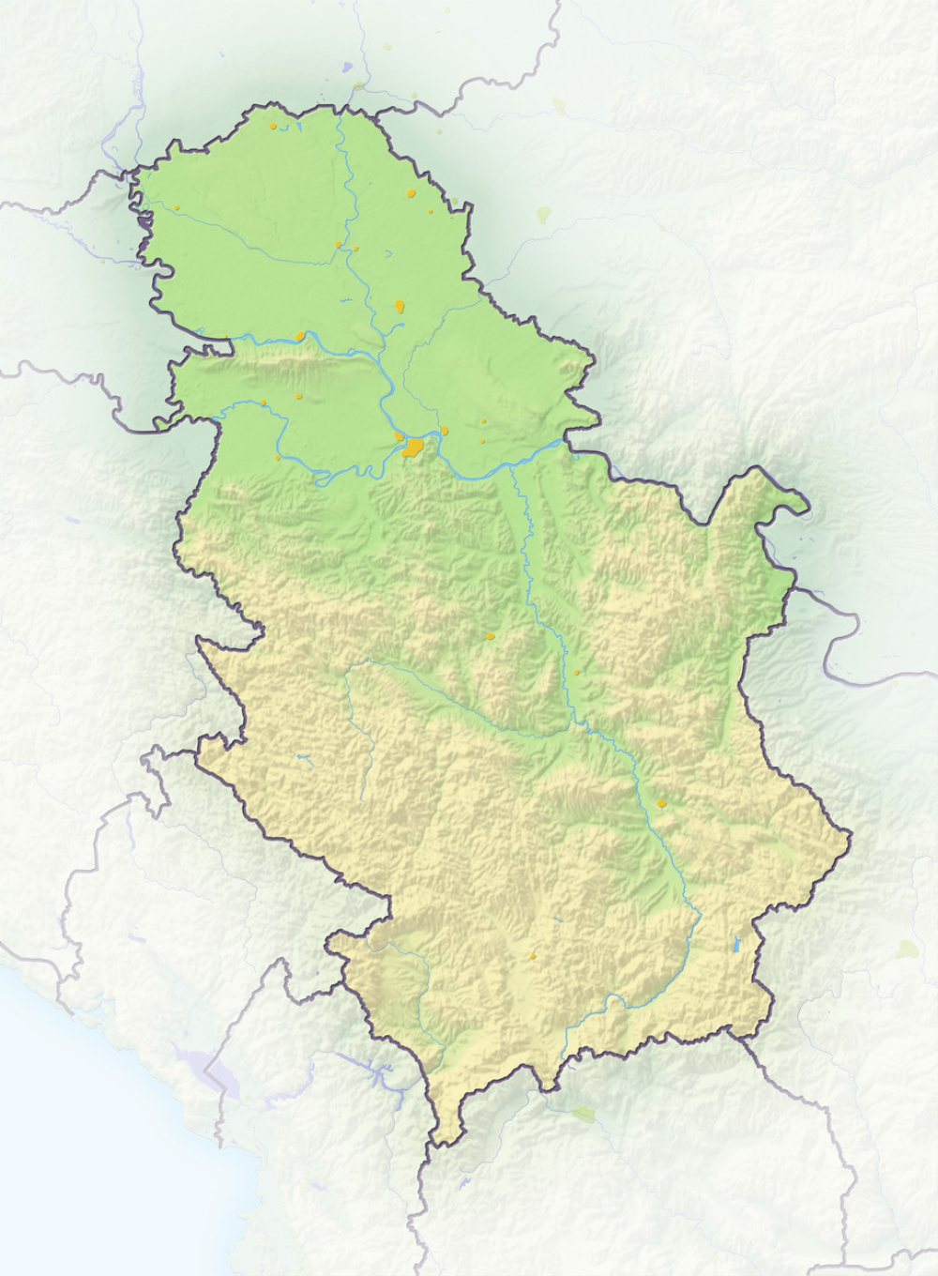
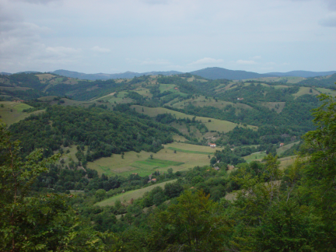
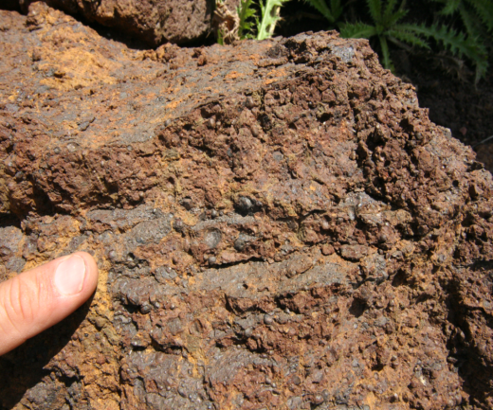
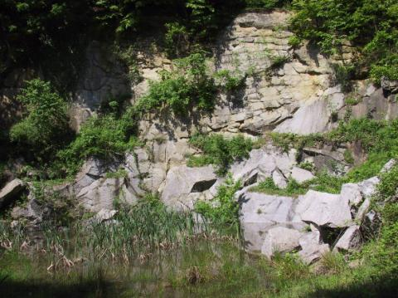
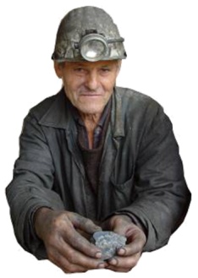
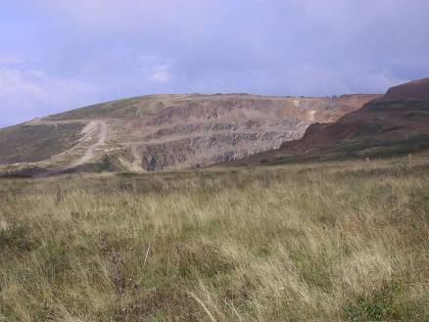
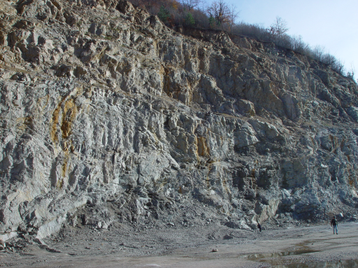
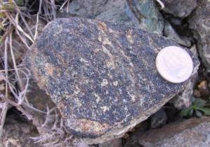
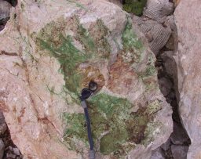
Antimony
Mercury
Tungsten
Bauxite
Uranium
Iron
Molybdenum
Chromium
Nickel and cobalt

Slide 24
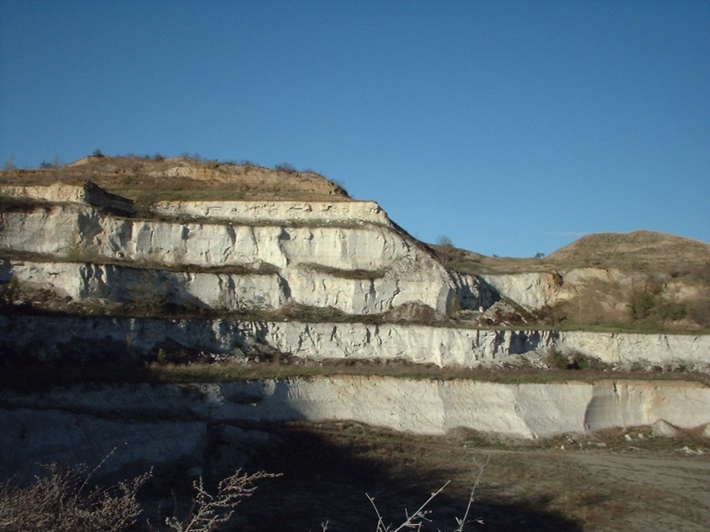
NON-METALLIC MINERAL RESOURCES
OF SERBIA
43 EuroGeoSurveys General Meeting (EGS) - 43 Directors Workshop – Mineral Resources Potential
Jovanović, 2007-2011: Mineral resources and potencial prognosis of non-metallic mineral raw materials in Serbia.
Photo: Marl, Beočin
There are more then 2500 non-metallic mineral deposits (industrial minerals) and mineral occurrences at territory of Serbia

Slide 25
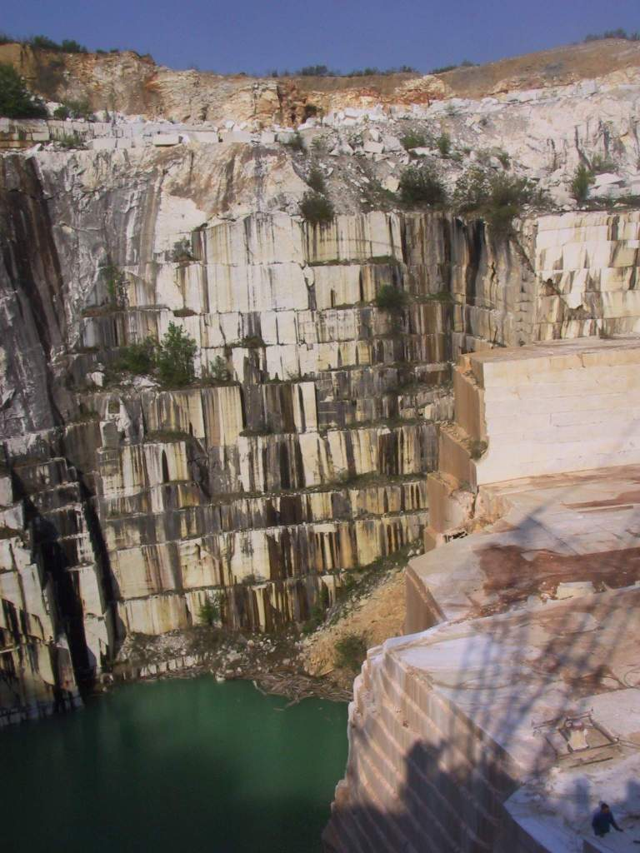
43 EuroGeoSurveys General Meeting (EGS) - 43 Directors Workshop – Mineral Resources Potential
Statistics
1946-2017 - explored:
46 non-metalic raw materials
Mineragenetic reonization:
26 mineragenetic districts
54 ore field
40 ore-bearing formations
Geological Survey of Serbia

Slide 26
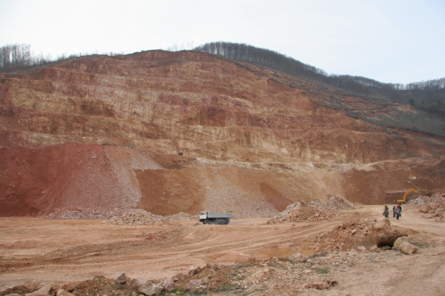
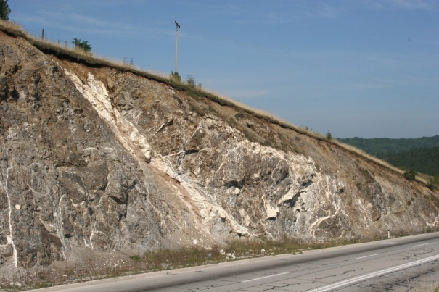
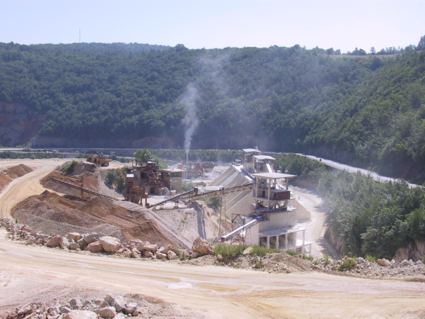
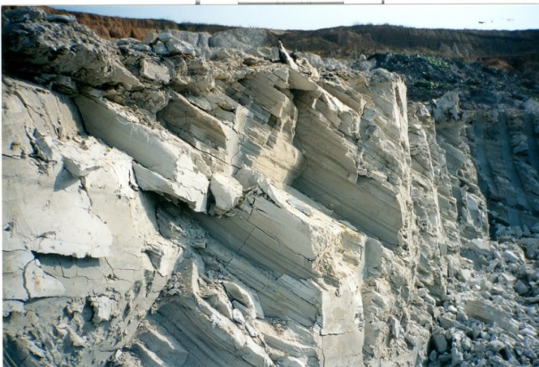
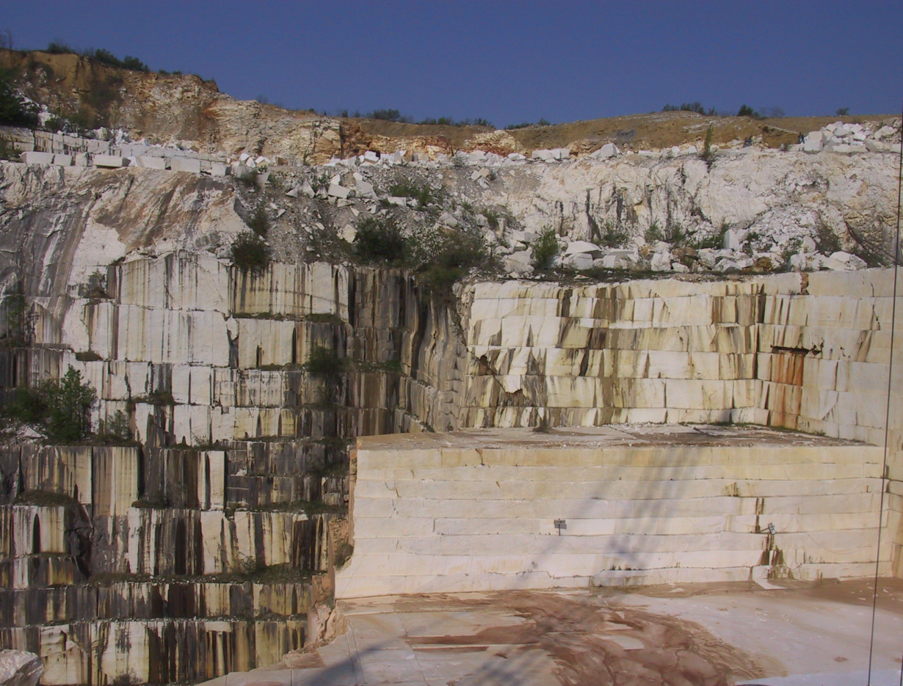
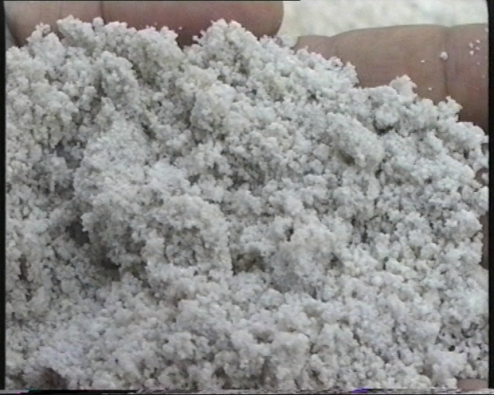
16 non-metalic mineral raw materials are in exploitation at 180 locations
200 non-metallic mineral deposits is prepared for exploitation or potentialy significant
Bentonite
Boron minerals
Refractory clay
Gypsum
Diatomite
Dolomite
Zeolite
Kaoline
Quartz sand
Cement marls
Ceramic clay
Limestone
Magnesite
Phosphates
Chrysotile-asbestos
Building industry granulates
Decorative stone
Raw materials for cement industry
Magnesite deposits
Deposits of limestone, and dolomite
Ceramic clays
Technical and architectural stone
Quartz sand

Slide 27
Classification:
1. Industrial minerals and rocks in exploitation or exploited:
Building construction industry granulates and decorative stone, barite, dolomite, kaoline, common clay, feldspars, white bauxite, zeolites, bentonite, cement marl, ceramic and refractory clay, natural mineral pigments, expanding clay, limestone, gypsum, diatomite, petrurgical rocks, magnesite, siliceous rocks /quartz sand, quartzite, opal, fluorite)
2. Industrial minerals whose resources and quality are partly determined, but which were not exploited in the past:
Boron and lithium minerals
3. Industrial minerals and rocks with conditionally economic reserves:
Phosphates, wollastonite, alunite, alumosilicates, vermiculite, garnets, pyrophylite, and
4. Minerals likely to be found in Serbia - Salt and mica.
Geological Survey of Serbia

Slide 28
43 EuroGeoSurveys General Meeting (EGS) - 43 Directors Workshop – Mineral Resources Potential
Industrial minerals and rocks | Measured + Indicated, Mt | Inferred, Mt
Ceramic clay | 18.20 | 16
Refractory clay | 5.25 | 32
Flint-clay | 1.72 | 5.5
Bentonite | 2.56 | 10.5
Building industry granulates | 230 | 500
Graphite | 0.386 | 0.12
Marble | 25 | 30
Quartz – veins Q– pegmatites Q – alluvial | 0.48 0.034 | 0.5 0.23 0.2
Barite | 0.246 | 0.16
Borates | 8 | 124
Asbestos | 2.15 | 3
Gypsum | 0.0285 | 0.42
K-feldspar Na-K-feldspar | 3.125 1.15 | 7.5 5.85
Fluorspar | 0.72 | 0.5
Industrial minerals and rocks | Measured + Indicated, Mt | Inferred, Mt
Mica | - | 0.025
Phosphates | 85.85 | 158
Zeolites | 0.49 | 2.65
Dunite (petrolurgy) | 8.13 | 24
Gravel+sand | 75 Mm³
Diatomites | 0.62 | 25
Alunite | - | 11
Andalusite distene silimanite | 0.056 | distene 0.2 andal. 0.11 silim. 0.04
Sepiolite | 0.0067 | 0.33
Alamandine | - | 0.42
Talc | - | 0.23
Vermiculite | - | 0.56
Wolastonite | - | 1.28
Pigments | 0.3 | 0.12
Gem stones |  | 0.485
Geological Survey of Serbia

Slide 29
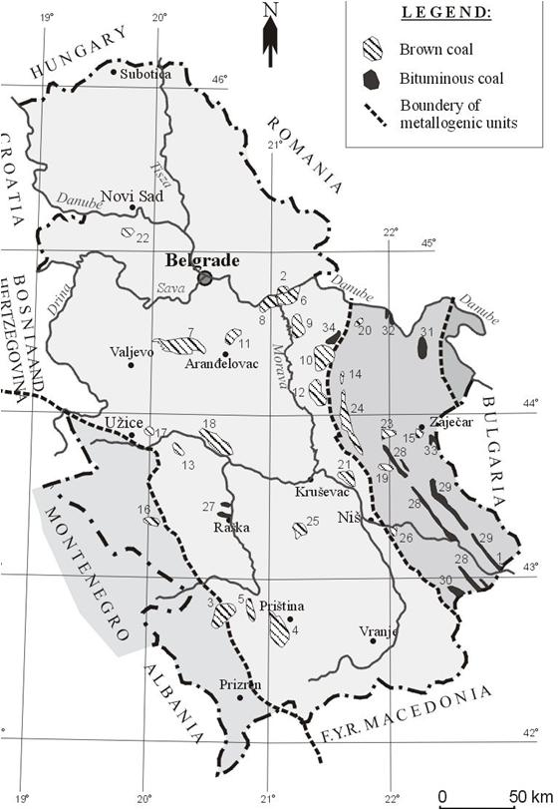
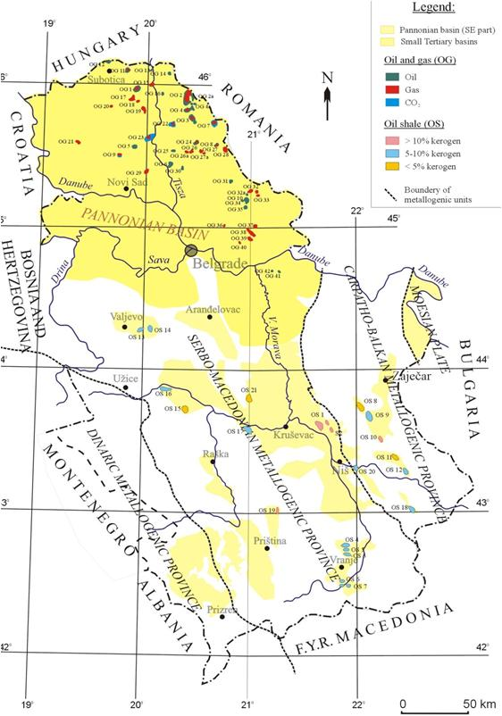
Fossil fuel resources of Serbia
43 EuroGeoSurveys General Meeting (EGS) - 43 Directors Workshop – Mineral Resources Potential
Kostić, 2007-2011: Mineral resources and potencial prognosis of fossil fuels in Serbia.
COAL
OIL and GAS
OIL SHALE
Geological Survey of Serbia

Slide 30
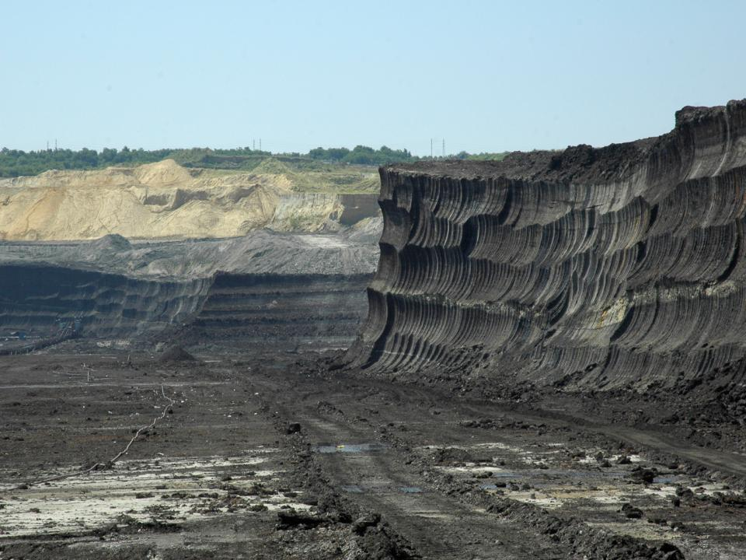
43 EuroGeoSurveys General Meeting (EGS) - 43 Directors Workshop – Mineral Resources Potential
Coal
13 bituminous coal basins (2 in exploitation)
33 brown coal basins (11 in exploitation)
BROWN COAL IN SERBIA
Annual production: 45 Mt
(exl. Kosovo basin)
Mineral resources - Main coal basins:
  Kosovo basin 6.4 Bt
  Kolubara basin 3.3 Bt
  Kostolac basin 2.4 Bt
  Metohija basin 0.7 Bt
  Kovin deposit 0.3 Bt
13.1 Bt
Geological Survey of Serbia

Slide 31
43 EuroGeoSurveys General Meeting (EGS) - 43 Directors Workshop – Mineral Resources Potential
Productive region:
Pannonian basin – Banat depression
90 Oil and gas fields
Velebit, Kikinda, Mokrin, Kikinda-varoš, Elemir, Turija sever,...
Kostić, 2007-2011: Mineral resources and potencial prognosis of fossil fuels in Serbia.
Most important discoveries were made over 40 years ago.
More than 30 small fields, with areas less than 5 km² .
Geological Survey of Serbia

Slide 32
Oil shale
43 EuroGeoSurveys General Meeting (EGS) - 43 Directors Workshop – Mineral Resources Potential
Tertiary lacustrine oil shale - lamosite
Kerogen: type I and II, mostly <10 %
Maturity: generally < 0,45 % Rr
Oil yield (Fischer assay): mostly below 5 %
Estimated resources: ~ 5 Bt of shale
Significant deposit : Aleksinac
Area 20 km², 2 layers (20 and 75m)
20 - 25 % kerogen
Oil yield: 10 - 12 % 90 l / t; 400 m³ of gas / t
Resources: 2.1 Bt of oil shale
In-place shale oil : 210 Mt
Geological Survey of Serbia

Slide 33
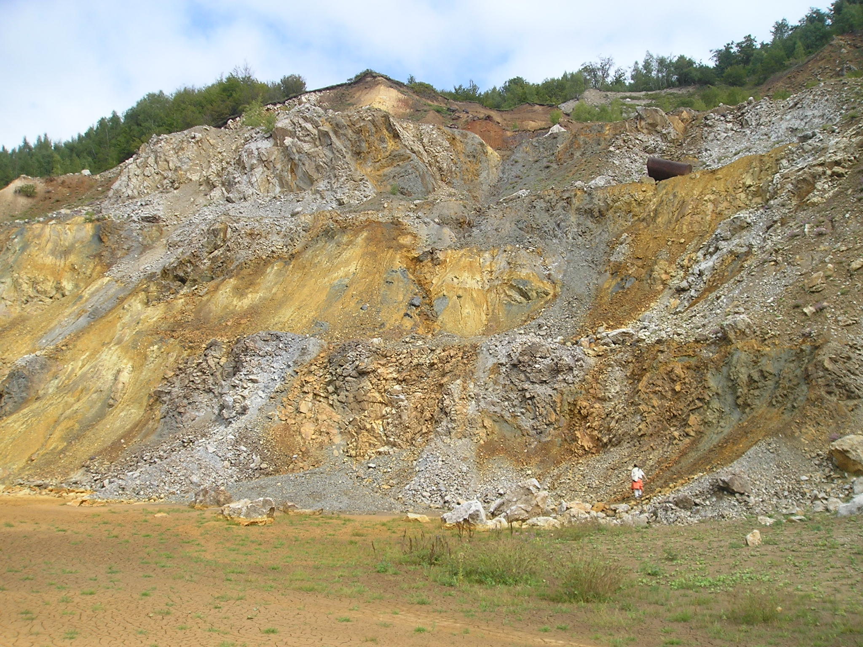
Mineral potential of Serbia
43 EuroGeoSurveys General Meeting (EGS) - 43 Directors Workshop – Mineral Resources Potential
... is believed to be more significant than its past and present production ...
Geological Survey of Serbia

Slide 34
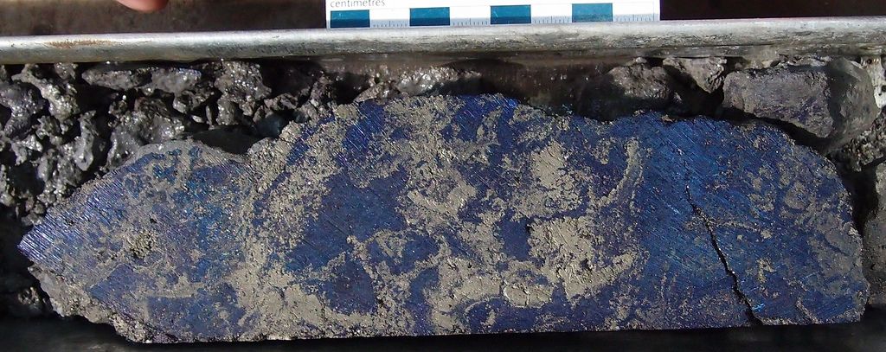
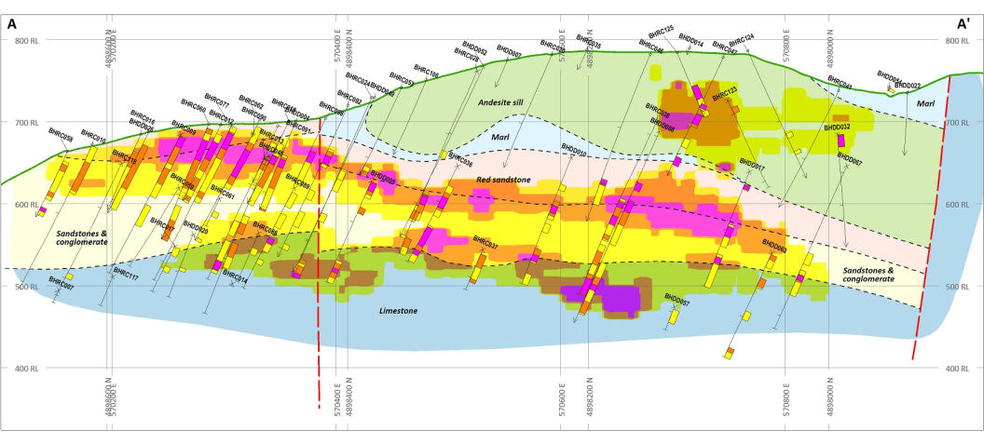


Examples:
Porphyry copper and massive sulphide Cu-Au system Čukaru Peki (Brestovac – Bor / Freeport and Nevsun comp.)
Sediment-hosted gold deposit (Potoj Cuka – Tisnica / Avala Resources and DPM comp)
Lithium deposit (Jadar basin / Rio Sava company)
Its require significant financial investments in geological exploration, systematic work of companies that have significant financial resources, technical resources and experience.
 | Drill Hole FMTC1213, 508-509m, 36.51 % Cu, 8.50 g/t Au, 41.61 CuEq%, Massive Sulphide Breccia
Cu - Bor
Au - Bigar
Li - Jadar

Slide 35




43 EuroGeoSurveys General Meeting (EGS) - 43 Directors Workshop – Mineral Resources Potential
Rakita Exploration

Slide 36





Slide 37


43 EuroGeoSurveys General Meeting (EGS) - 43 Directors Workshop – Mineral Resources Potential

Slide 38





SEDIMENT-HOSTED
GOLD MINERALIZATION
‘Potaj Čuka–Tisnica Au belt’
Korkan
TMK
Lenght (N-S): 25 km, Width: 10 km
Bigar Hill
Kraku Pestar
Valja Strž monconite
25km
Bigar Hill
Umka
Cretaceous sediments (limestone, clastite)
Soil geochemistry – Aau anomalies

Slide 39

43 EuroGeoSurveys General Meeting (EGS) - 43 Directors Workshop – Mineral Resources Potential
81 t Au
Deposit |  | Timol Gold Project – Indicated and Inferred Resources used in the PEA
 | Cut-off Grade (Au, g/t) | Indicated |  |  |  | Inferred
 |  | Ore, Mt | Au (g/t) | Au (Moz) | Au (t) | Ore, Mt | Au (g/t) | Au (Moz) | Au (t)
Bigar Hill | 0.3 | 38.62 | 1.19 | 1.48 | 45.96 | 1.3 | 1.3 | 0.1 | 1.69
Korkan | 0.3 | 22.35 | 1.07 | 0.77 | 23.91 | 2.7 | 0.9 | 0.1 | 2.43
Kraku Pešter | 0.3 | 6.45 | 1.05 | 0.22 | 6.77 | 0.3 | 0.8 | 0.8 | 0.24
Total: |  | 67.42 | 1.14 | 2.48 | 76.64 | 4.3 | 1 | 0.2 | 4.36
Korkan East | 2 |  |  |  |  | 1.37 | 3.4 | 0.147 | 4.66

Slide 40




Slide 41


1. Legislation
2. Exploitation
3. Ecology ...
Mineral Resources in the Serbia:
A Driving Force for Economic Development – Limitations !
Limitations

Slide 42

It is mandatory to create tree basic documents:
43 EuroGeoSurveys General Meeting (EGS) - 43 Directors Workshop – Mineral Resources Potential
1. Legislation
Law on Mining and Geological Exploration, 2015
Management Strategy of mineral and other resources of Republic of Serbia
Adopted by the National Assembly on a Ministry of Mines proposal for a period of at least 10 years.
Strategy Implementation Plan
Adopted by the Government on the proposal of the MME for a period from 2 to 10 years.
The program for the realization of the Strategy
Adopted by the Government on the proposal of the Ministry for a period of 10 years.

Slide 43

43 EuroGeoSurveys General Meeting (EGS) - 43 Directors Workshop – Mineral Resources Potential
1. Legislation
Conclusion
Mineralna politika
Mineral Policy
1) Urgent development of strategic documents for the protecting the economic and other interests of Serbia.
2) The use of mineral resources with maximum benefits.
3) Development of modern, so-called sustainable mining, which is based on three pillars: economy, environment and social pillar.
Strategija, plan i program
Strategy, Plan, Program

Slide 44
Classification of geological exploration
43 EuroGeoSurveys General Meeting (EGS) - 43 Directors Workshop – Mineral Resources Potential
1. Legislation
Second key issue
1965 - 2011. godine
Performed by state companies (Geozavod, Geoinstitute,...)
GSS
Basic geological exploration | I phase | 1:1,000,000 – 1:25,000 (Mapping, Prognostic resources – D₂, D₁)
 | II phase
 | III phase | Exploration in ore districts, ore zones, ore fields, 1:10.000-1:5.000 (Determination of C₂ and C₁-category of mineral reserves)
 | IV phase
Detailed geological exploration | Exploration of mineral deposits (Determination of A, B and C₁-category of mineral reserves)
Reconnaissance
Prospection
General exploration
Performed by mines, private and state companies
(Geozavod, Geoinstitute,...)

Slide 45

Law of mining and geological exploration (2011, 2015)
43 EuroGeoSurveys General Meeting (EGS) - 43 Directors Workshop – Mineral Resources Potential
New classification
Geological Survey of Serbia
Companies

Slide 46


43 EuroGeoSurveys General Meeting (EGS) - 43 Directors Workshop – Mineral Resources Potential
Pan-European Code for Reporting of Exploration Results, Mineral Resources and Reserves – PERC Code, 2008
CRIRSCO Template - Committee for Mineral Reserves International Reporting Standards - Združeni komitet za međunarodne standarde u izveštavanju o mineralnim rezervama
DRAFT: Ruls for reporting of exploration results, mineral resources and reserves of solid mineral raw materials and their classification
2012
Draft
Third key issue

Slide 47


43 EuroGeoSurveys General Meeting (EGS) - 43 Directors Workshop – Mineral Resources Potential
3D model
The Book of Regulations on Classification and Categorization of Reserves of Solid Mineral Raw Materials and Keeping a File on Them
(issued in former SFR Yugoslavia, 1979)
The existing Classification, as well as the belonging Pravilnik, are mostly obsolete, expired and in discord with modern world standards.
The term 'mineral resources' is not recognized !

Slide 48
43 EuroGeoSurveys General Meeting (EGS) - 43 Directors Workshop – Mineral Resources Potential
The fourth ... key issue
Licences (exploration geologists, mining engineers), Mining Royalties,...
Databases:
  Geological database – GeolIS
  Mining database – Ministry of mining and energy
  (exploration and exploitation rights,...)
  Dumps – Institute for Mining and Metallurgy-Bor
  ...

Slide 49
The required conditions
43 EuroGeoSurveys General Meeting (EGS) - 43 Directors Workshop – Mineral Resources Potential
Mineral Resources in the Serbia: A Driving Force for Economic Development
Significant mineral potential (1945-2000)
Positive exploration results (2001-2017)
Legislation
Thank you for your attention !

